Slide 1


BIOINFORMATICS and ARTIFICIAL INTELLIGENCE
RNA-SEQ CLASSIFICATION
PROBLEM
RNA-SEQ CLASSIFICATION
METHODOLOGY
MLSeq 2.0
CONCLUSION
REFERENCES
Assoc.Prof.Dr. Gökmen ZARARSIZ
gokmenzararsiz@erciyes.edu.tr
Erciyes University, Faculty of Medicine, Department of Biostatistics
Erciyes University, Drug Application and Development Research Center
May 14, 2022
Notes:
Good afternoon everyone. Three years ago, we presented MLSeq, an R/BIOCONDUCTOR package, to researchers to apply machine-learning classifiers for the problem of RNA-Seq classsification. Now, we have made significant improvements and released the second version of the software. Today, I will talk about what you can do with MLSeq.

Slide 2
RNA-SEQ ANALYSIS WORKFLOW
STATISTICAL and MACHINE LEARNING APPROACHES for
RNA-SEQ DATA
GÖKMEN ZARARSIZ
INTRODUCTION to RNA-SEQ TECHN.
NORMALIZATION
MODELING
HYPOTHESIS TESTING
CLASSIFICATION
CONCLUSION
REFERENCES
Biological question
Experimental design
RNA isolation
Library construction
Sequencing
QA and filtering
Alignment
Feature counting
Normalization and transformation
Differential expression
GO & pathway analysis
De novo transcriptome assembly
(for non-model organisms)
Classification analysis
Clustering analysis
Model validation
Cluster validation

Slide 3
BIOLOGICAL QUESTION
STATISTICAL and MACHINE LEARNING APPROACHES for
RNA-SEQ DATA
GÖKMEN ZARARSIZ
INTRODUCTION to RNA-SEQ TECHN.
NORMALIZATION
MODELING
HYPOTHESIS TESTING
CLASSIFICATION
CONCLUSION
REFERENCES
Class comparison
Which genes are differentially expressed among :
Tumor/non-tumor samples
Tissue samples
Tissue developmental stages
What roles do these significant genes have in related pathways?
Class discovery
Can we find gene clusters to identify co-expressed genes or find sample clusters to detect disease subtypes?
Class prediction
Can we develop gene-expression based classifiers for molecular disease profiling?
Notes:
With RNASeq technology, it is possible to work with any genomic features, a pre-defined subset of transcriptomes, such as transcript, exon or gene. For simplicity of language, in this presentation I will assume that these genomic features refer to genes.

Slide 4
EXPERIMENTAL DESIGN
STATISTICAL and MACHINE LEARNING APPROACHES for
RNA-SEQ DATA
GÖKMEN ZARARSIZ
INTRODUCTION to RNA-SEQ TECHN.
NORMALIZATION
MODELING
HYPOTHESIS TESTING
CLASSIFICATION
CONCLUSION
REFERENCES
Why experimental design?
Maximize collected information – minimize experiment costs
Basic principals – Fisher (1935)
Randomization, replication and blocking
Unreplicated or replicated?
Technical or biological replicates?
Increasing the number of biological replicates (at least 3 for statistical testing) increases the precision and generalizability of the results
Notes:
One biological replicate per treatment group.
Pros: Cheap, and can be informative.
Cons: We can only make inferences about the particular biological individuals
not the treatment groups.
Applications: Pilot studies, non-model organism runs focused on reference transcriptome assembly.
-
Multiple biological replicate per treatment group.
Pros: We can make inferences about the treatment groups, and we can be
more conﬁdent about our inferences.
Cons: More expensive.
Applications: Differential expression (and alternative splicing) analysis to make
inferences about treatment groups, reliably infer networks.
-
Biological replicates contain multiple individuals; technical replicates contain
one individual with some technical steps replicated.
Usually biological variance > technical variance, thus biological replicates are
more useful. Again, they also allow us to make inferences about the treatment
groups.

Slide 5
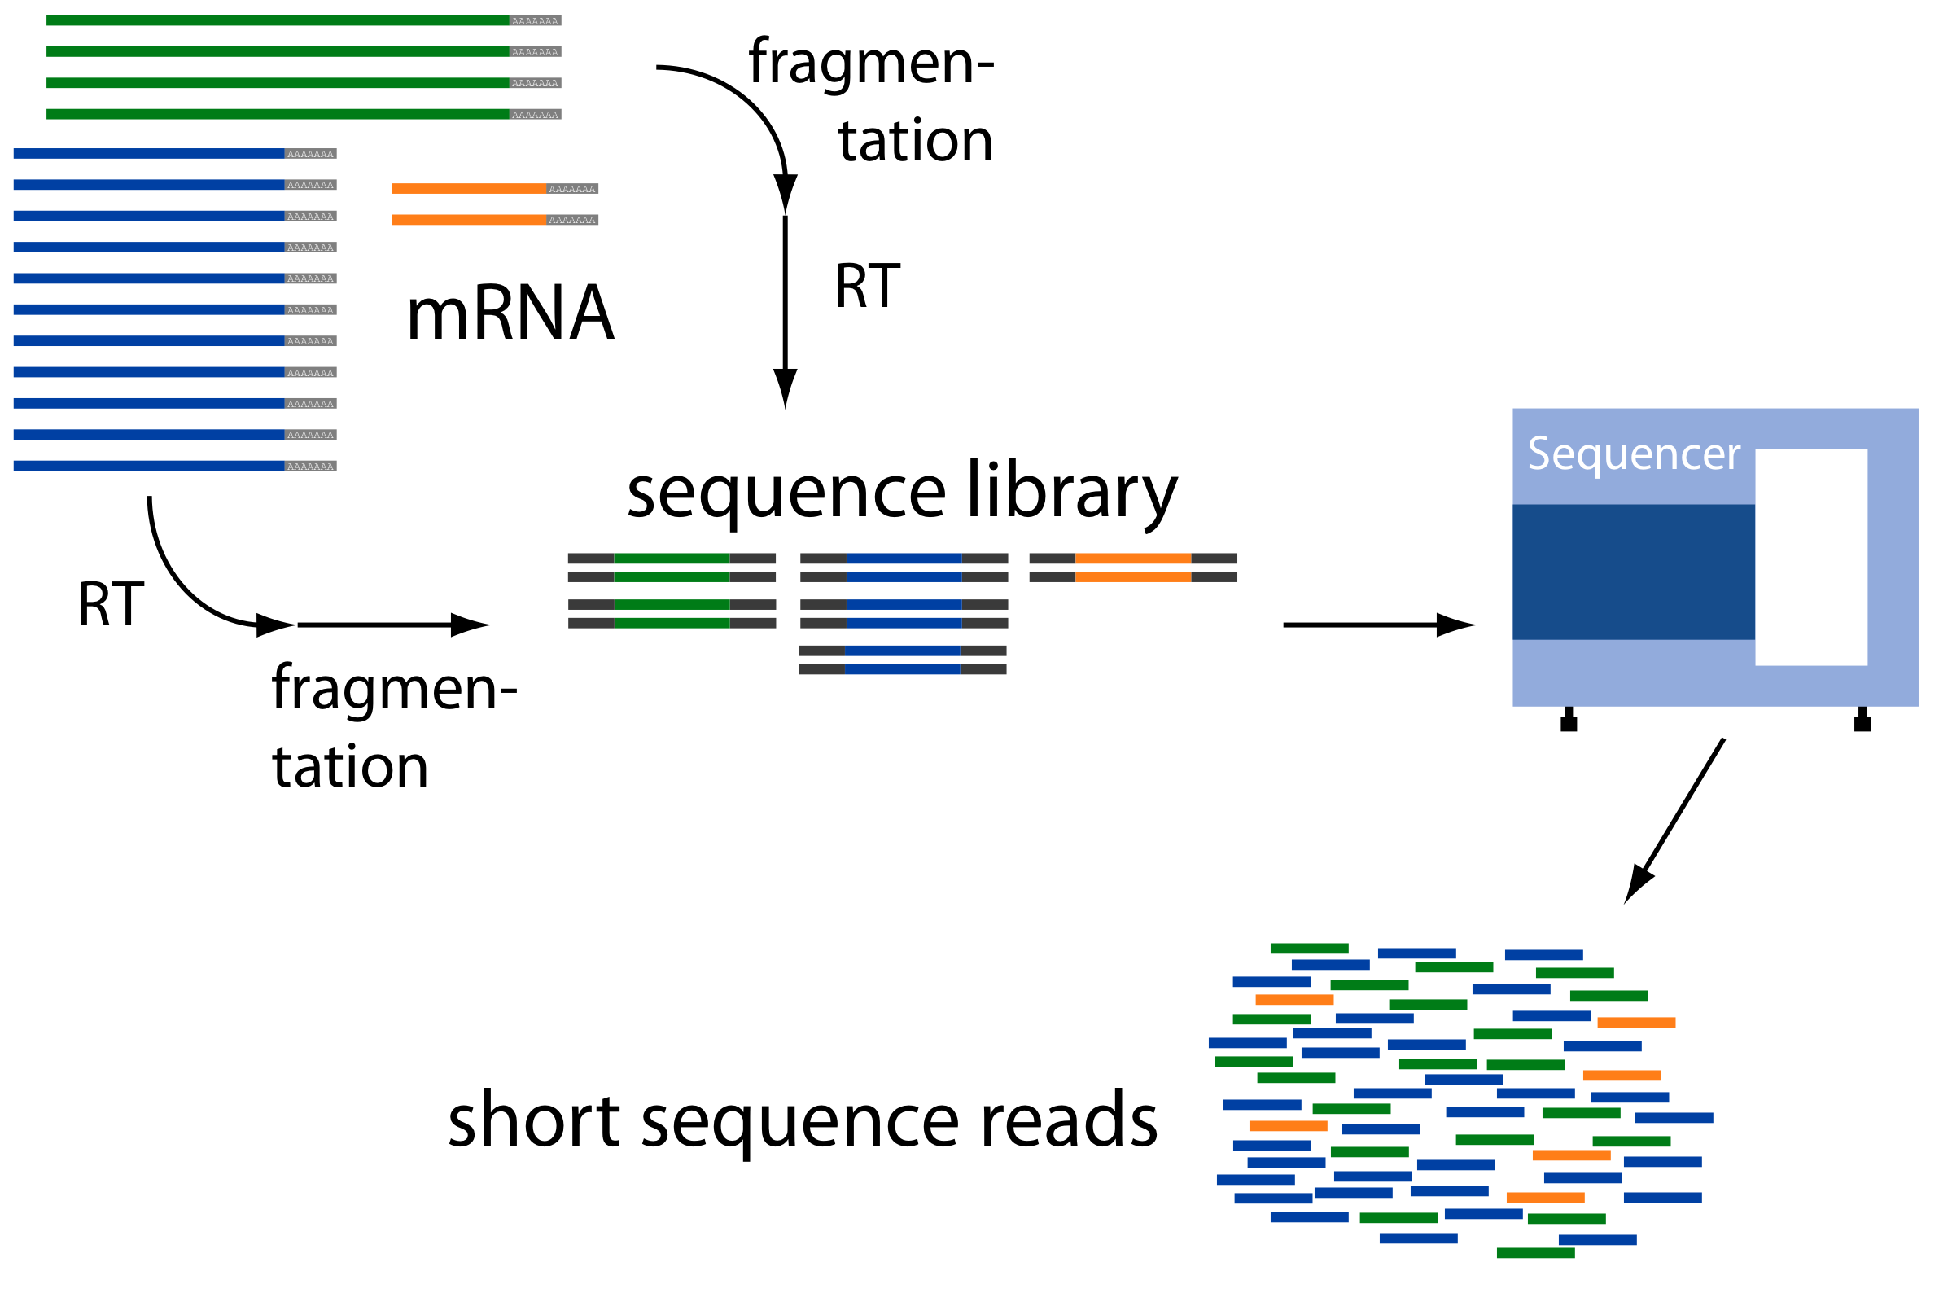
EXPERIMENTAL PROCESS
STATISTICAL and MACHINE LEARNING APPROACHES for
RNA-SEQ DATA
GÖKMEN ZARARSIZ
INTRODUCTION to RNA-SEQ TECHN.
NORMALIZATION
MODELING
HYPOTHESIS TESTING
CLASSIFICATION
CONCLUSION
REFERENCES
http://raetschlab.org

Slide 6
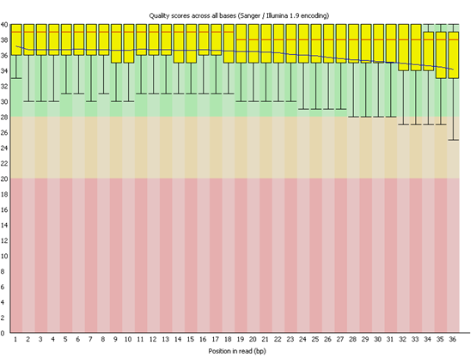
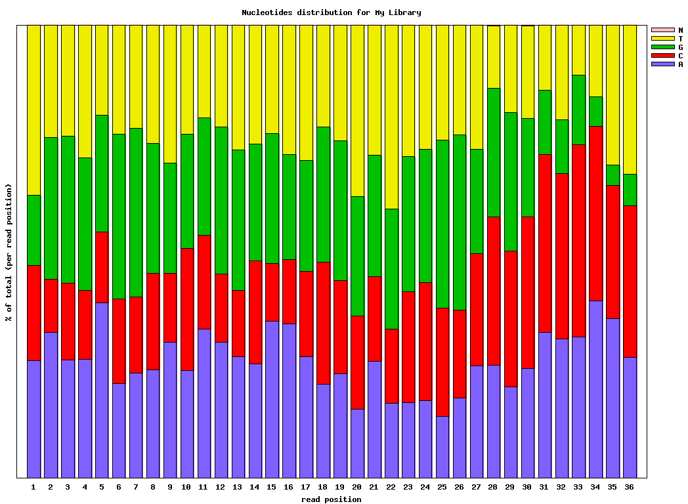
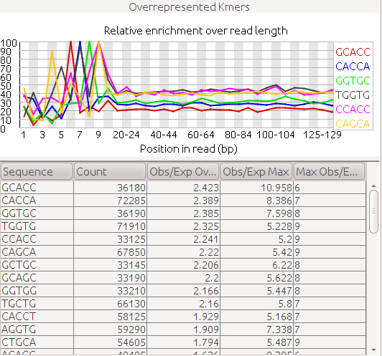
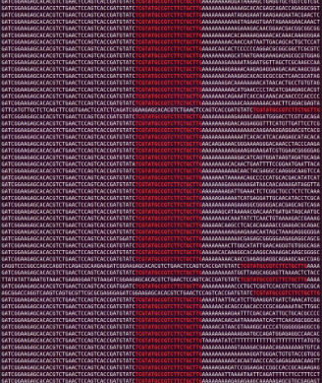
QUALITY ASSESSMENT and FILTERING
STATISTICAL and MACHINE LEARNING APPROACHES for
RNA-SEQ DATA
GÖKMEN ZARARSIZ
INTRODUCTION to RNA-SEQ TECHN.
NORMALIZATION
MODELING
HYPOTHESIS TESTING
CLASSIFICATION
CONCLUSION
REFERENCES

Slide 7
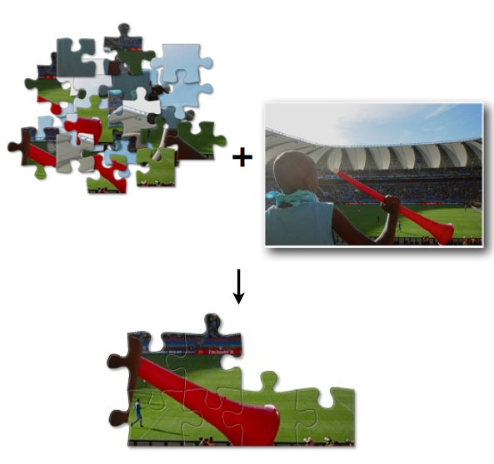
ALIGNMENT
STATISTICAL and MACHINE LEARNING APPROACHES for
RNA-SEQ DATA
GÖKMEN ZARARSIZ
INTRODUCTION to RNA-SEQ TECHN.
NORMALIZATION
MODELING
HYPOTHESIS TESTING
CLASSIFICATION
CONCLUSION
REFERENCES
Hansen KD, Short read alignment (using external tools), CSAMA’11, Brixen, Italy
Notes:
Genom alignmenttan farklı, splice junctionlar dikkate alınmalı

Slide 8
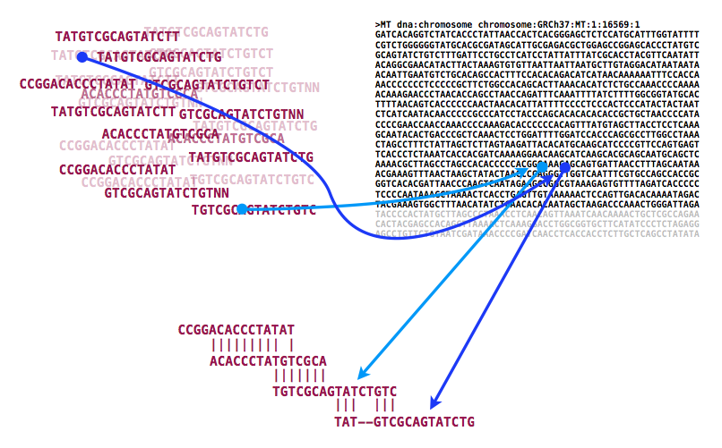
ALIGNMENT
STATISTICAL and MACHINE LEARNING APPROACHES for
RNA-SEQ DATA
GÖKMEN ZARARSIZ
INTRODUCTION to RNA-SEQ TECHN.
NORMALIZATION
MODELING
HYPOTHESIS TESTING
CLASSIFICATION
CONCLUSION
REFERENCES
Hansen KD (2011), Short read alignment (using external tools), CSAMA’11, Brixen, Italy
Notes:
Genom alignmenttan farklı, splice junctionlar dikkate alınmalı

Slide 9
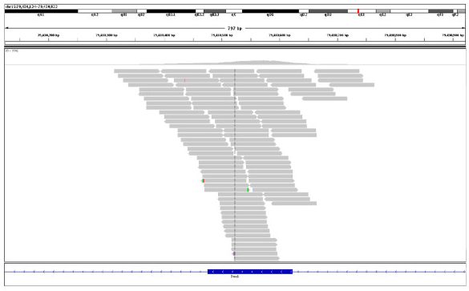
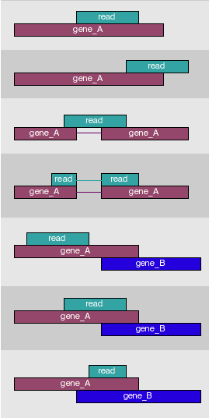
FEATURE COUNTING
STATISTICAL and MACHINE LEARNING APPROACHES for
RNA-SEQ DATA
GÖKMEN ZARARSIZ
INTRODUCTION to RNA-SEQ TECHN.
NORMALIZATION
MODELING
HYPOTHESIS TESTING
CLASSIFICATION
CONCLUSION
REFERENCES
# of mapped reads mRNA abundance
http://www-huber.embl.de/users/anders/HTSeq/doc/count.html

Slide 10
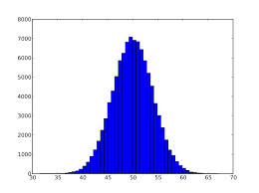
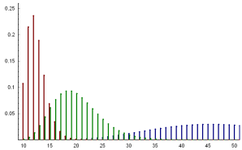

MİKROARRAY ve RNA-DİZİLEME VERİLERİ
RNA-DİZİLEME VERİLERİ İLE GEN EKSPRESYONUNA DAYALI SINIFLANDIRMADA YENİ BİR YAKLAŞIM VE MLSEQ R/BIOCONDUCTOR YAZILIMI
GÖKMEN ZARARSIZ
RNA-DİZİLEME ve SINIFLANDIRMA
BAGGING DVM
VERİ SETLERİ
BULGULAR
TARTIŞMA/SONUÇ
MLSeq R PAKETİ
KAYNAKLAR
Gee | G1iNS1 | G144 | G166 | G179 | CB541 | CB660
13CDNA73 | 3.158 | 2.659 | 1.621 | 1.564 | 4.269 | 3.441
A2BP1 | 2.015 | 2.049 | 3.867 | 2.006 | 1.698 | 1.988
A2M | 3.655 | 2.699 | 1.966 | 4.526 | 4.658 | 5.124
A4GALT | 2.598 | 5.689 | 0.498 | 2.557 | 3.478 | 2.619
AAAS | 4.129 | 5.254 | 3.698 | 2.598 | 3.647 | 1.991
AACS | 2.549 | 4.523 | 4.116 | 3.987 | 2.386 | 3.447
AADACL1 | 6.251 | 4.256 | 3.698 | 4.251 | 2.500 | 2.824
[…]
Mikroarray verisi
Sürekli dağılımlar
Normal vb.
Gen | G1iNS1 | G144 | G166 | G179 | CB541 | CB660
13CDNA73 | 4 | 0 | 6 | 1 | 0 | 5
A2BP1 | 19 | 18 | 20 | 7 | 1 | 5
A2M | 2724 | 2209 | 13 | 49 | 193 | 548
A4GALT | 0 | 0 | 48 | 0 | 0 | 0
AAAS | 57 | 29 | 224 | 49 | 202 | 92
AACS | 1904 | 1294 | 5073 | 5364 | 3737 | 3511
AADACL1 | 3 | 13 | 239 | 683 | 158 | 40
[…]
RNA-dizileme sayma verisi
Kesikli dağılımlar
Poisson, negatif binom vb.

Slide 11
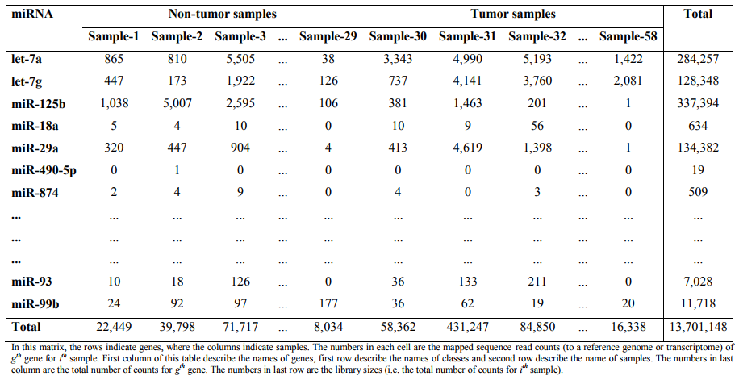
RAW RNA-SEQ DATA
MLSeq 2.0: MACHINE-LEARNING INTERFACE FOR RNA-SEQUENCING DATA
GÖKMEN ZARARSIZ
RNA-SEQ CLASSIFICATION
PROBLEM
RNA-SEQ CLASSIFICATION
METHODOLOGY
MLSeq 2.0
CONCLUSION
REFERENCES
Library sizes (# of total counts per sample) are mostly different across samples
Notes:
This is an RNA-Seq data including raw counts and an example input to our software. Rows represent the genomic features, which may be genes, transcripts or miRNAs. Columns refer to the samples. The column totals are called as library sizes. Because of the experimental procedures, these library sizes are mostly different across samples and affect the counts in this table.

Slide 12
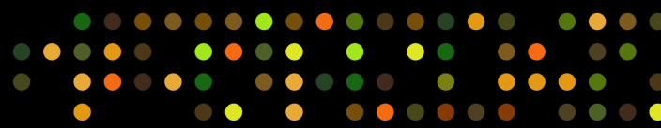
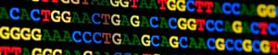

MICROARRAYS & RNA-SEQ
BIOINFORMATICS and ARTIFICIAL INTELLIGENCE
GÖKMEN ZARARSIZ
RNA-SEQ CLASSIFICATION
PROBLEM
RNA-SEQ CLASSIFICATION
METHODOLOGY
MLSeq 2.0
CONCLUSION
REFERENCES
MICROARRAYS
Outdated technique
Not able to detect novel transcripts
Noisy
Requires prearranged transcripts of interest
Thousands of studies
Numerous methods
RNA-Seq
State-of-the art technique
Able to detect novel transcripts
Less noisy
No requirement for prearranged transcripts of interest
Still less advancements
Pretty small number of methods
ADVANTAGES & DISADVANTAGES
DATA DISTRIBUTION
Gene | G1iNS1 | G144 | G166
13CDNA | 3.158 | 2.659 | 1.621
A2BP1 | 2.015 | 2.049 | 3.867
A2M | 3.655 | 2.699 | 1.966
[…]
Gene | G1iNS1 | G144 | G166
13CDNA | 4 | 0 | 6
A2BP1 | 19 | 18 | 20
A2M | 2724 | 2209 | 13
[…]
Continuous data
Normal, etc.
Discrete data
Poisson, NB, etc.
Overdispersed
GENE-EXPRESSION BASED CLASSIFICATION
Notes:
In our last three conferences, I have talked too much about the RNA-Seq classification problem. Today, I will give a brief overview. Gene-expression based classification is an important task in genomics, mostly for molecular diagnosis. Using gene-expression data, we can predict whether a subject is cancer or not, or we can predict the disease subtype or stage, and so on. Two high-throughput techniques to quantify the gene expression, microarrays and next-generation RNA-sequencing. With important advantages, RNA-Seq has replaced microarrays as the technology of choice, and now it is currently the de facto standard approach for transcriptome analysis. So, why do I still talk about microarrays? Because, for the gene-expression based classification problem, there are quite a lot algorithms have been developed for microarrays. And most of these algorithms are not used today due to the technological update. Microarray data has continuous values, while RNA-Seq data has discrete count values and is highly overdispersed.

Slide 13
RNA-SEQ CLASSIFICATION (METHODS)
MLSeq 2.0: MACHINE-LEARNING INTERFACE FOR RNA-SEQUENCING DATA
GÖKMEN ZARARSIZ
RNA-SEQ CLASSIFICATION
PROBLEM
RNA-SEQ CLASSIFICATION
METHODOLOGY
MLSeq 2.0
CONCLUSION
REFERENCES
DISCRETE CLASSIFIERS
PLDA - Poisson-linear discriminant analysis (Witten et al., 2011)
NBLDA - Negative-binomial linear discriminant analysis (Dong et al., 2015)
MICROARRAY-BASED CLASSIFIERS
Microarray-based classifiers after proper transformations (Zararsiz et al., 2014; Zararsiz et al., 2017)
VoomDDA - Voom-based diagonal discriminant classifiers (Zararsiz et al., 2017)
Notes:
There are still less advancements to classify RNA-Seq data. Witten developed Poisson linear discriminant analysis classifier. This classifier is not able deal with the overdispersion problem. And, the authors suggested applying a power transformation prior to classification analysis. To overcome the overdispersion problem, Dong proposed negative binomial linear discriminant analysis classifier. We published two papers. In first one, we suggested the application of microarray-based methods after proper transformations. I will talk about it later. And in second study, we developed three voom-based discriminant classifiers. We showed that these methods are superior to the others in terms of accuracy and sparsity.

Slide 14
RNA-SEQ CLASSIFICATION (SOFTWARES)
MLSeq 2.0: MACHINE-LEARNING INTERFACE FOR RNA-SEQUENCING DATA
GÖKMEN ZARARSIZ
RNA-SEQ CLASSIFICATION
PROBLEM
RNA-SEQ CLASSIFICATION
METHODOLOGY
MLSeq 2.0
CONCLUSION
REFERENCES
PoiClaClu: Classification and clustering of sequencing data based on a Poisson model (Witten et al., 2013)
R/CRAN package
Illustration of the PLDA classifier
https://cran.r-project.org/web/packages/PoiClaClu/index.html
MLSeq: Machine learning interface for RNA-Seq data (Zararsiz et al., 2014)
R/BIOCONDUCTOR package
Application of several microarray-based classifiers for RNA-Seq classification
https://bioconductor.org/packages/release/bioc/html/MLSeq.html
VoomDDA: Discovery of Diagnostic Biomarkers and Classification of RNA-Seq Data (Zararsiz et al., 2015)
Shiny web tool
Illustration of the voomDDA classifiers
http://www.biosoft.hacettepe.edu.tr/voomDDA/
Notes:
These were the methods. What about the softwares? Currently, three softwares are available. PoiClaClu is an R package, developed by Witten to illustrate their method. In 2014, we presented the MLSeq package to easify the application of several microarray-based classifiers to raw RNA-Seq count data. And finally, we provided voomDDA web tool to illustrate voom based classifiers. It is currently available through our web server at Hacettepe University.

Slide 15

MLSeq PACKAGE
MLSeq 2.0: MACHINE-LEARNING INTERFACE FOR RNA-SEQUENCING DATA
GÖKMEN ZARARSIZ
RNA-SEQ CLASSIFICATION
PROBLEM
RNA-SEQ CLASSIFICATION
METHODOLOGY
MLSeq 2.0
CONCLUSION
REFERENCES
Notes:
In the first release of MLSeq, we presented only 4 classifiers. These were support vector machines, its ensemble bagging support vector machines, random forests and classification trees.

Slide 16
MLSeq PACKAGE
MLSeq 2.0: MACHINE-LEARNING INTERFACE FOR RNA-SEQUENCING DATA
GÖKMEN ZARARSIZ
RNA-SEQ CLASSIFICATION
PROBLEM
RNA-SEQ CLASSIFICATION
METHODOLOGY
MLSeq 2.0
CONCLUSION
REFERENCES
New studies, literature changes
A vast amount of microarray-based classifiers are not used due to the technological update
MLSeq is popular and widely used
9,162 downloads (5,048 from distinct IPs, 17.10.2017)
Needs significant update
Aim to make MLSeq package more comprehensive and practical for users
Notes:
Now, there are new studies and we wanted to update our package. Besides this, we had other reasons. We wanted to reclaim the methods developed for microarrays, however abandoned due to the technological update. Moreover, MLSeq package was not comprehensive,but still very popular. We have users from all over the world, like from Broad Institute, European Bioinformatics Institute or Max-Planck Institute. Currently it has been downloaded more than 9.000 times. So, we wanted to make it more comprehensive, also practical for users.

Slide 17
RAW RNA-SEQ DATA
MLSeq 2.0: MACHINE-LEARNING INTERFACE FOR RNA-SEQUENCING DATA
GÖKMEN ZARARSIZ
RNA-SEQ CLASSIFICATION
PROBLEM
RNA-SEQ CLASSIFICATION
METHODOLOGY
MLSeq 2.0
CONCLUSION
REFERENCES
Library sizes (# of total counts per sample) are mostly different across samples
Notes:
This is an RNA-Seq data including raw counts and an example input to our software. Rows represent the genomic features, which may be genes, transcripts or miRNAs. Columns refer to the samples. The column totals are called as library sizes. Because of the experimental procedures, these library sizes are mostly different across samples and affect the counts in this table.

Slide 18
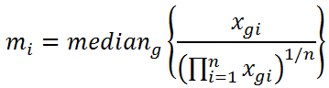
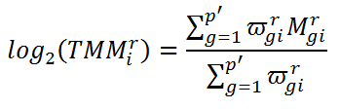
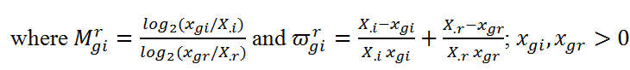
NORMALIZATION
MLSeq 2.0: MACHINE-LEARNING INTERFACE FOR RNA-SEQUENCING DATA
GÖKMEN ZARARSIZ
RNA-SEQ CLASSIFICATION
PROBLEM
RNA-SEQ CLASSIFICATION
METHODOLOGY
MLSeq 2.0
CONCLUSION
REFERENCES
Library sizes are dependent on the experimental design
Technical bias
Normalization for bias correction
Deseq median ratio normalization (Anders et al., 2010)
Trimmed mean of M values (TMM) normalization (Robinson et al., 2010)
Notes:
These differences are actually systematic biases and should be corrected. Thus, we need to normalize our data first. There are various normalization methods. Deseq median ratio and TMM are among the most powerful ones.

Slide 19
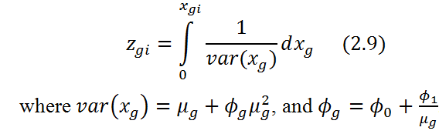
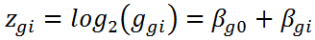
TRANSFORMATION
MLSeq 2.0: MACHINE-LEARNING INTERFACE FOR RNA-SEQUENCING DATA
GÖKMEN ZARARSIZ
RNA-SEQ CLASSIFICATION
PROBLEM
RNA-SEQ CLASSIFICATION
METHODOLOGY
MLSeq 2.0
CONCLUSION
REFERENCES
Required for microarray-based classifiers
Shifted log (less skew distribution, still unequal variances)
Variance-stabilizing transformation (vst)
Regularized log transformation (rlog)
Variance-modeling at observational level (voom)
Notes:
And after normalization, we can directly use a discrete classifier. Or we can transform the data and apply microarray-based classifiers. The simple approach is using a shifted-log transformation. Even the transformed data has less skew distribution with less extreme values, we still have unequal variances for all genes. Variance stabilizing transformation and regularized logarithmic transformation are approved as more robust approaches. Voom is a powerful method, it models the mean and variance relationship of the data at observational level. After the transformation, voom provides two matrix. First matrix is the transformed gene-expression data, and the second one is the precision weights in same dimension. So, a classifier should deal with both the transformed data and the weights data. That’s how voomDDA classifiers work.

Slide 20
RNA-SEQ CLASSIFIERS
MLSeq 2.0: MACHINE-LEARNING INTERFACE FOR RNA-SEQUENCING DATA
GÖKMEN ZARARSIZ
RNA-SEQ CLASSIFICATION
PROBLEM
RNA-SEQ CLASSIFICATION
METHODOLOGY
MLSeq 2.0
CONCLUSION
REFERENCES
Discrete classifiers (normalize the raw data, then classify):
Poisson linear discriminant analysis (PLDA)
Poisson linear discriminant analysis with power transformation (PLDA2)
Negative-binomial linear discriminant analysis (NBLDA)
VoomDDA classifiers (normalize the raw data, then classify):
Voom-based diagonal linear discriminant analysis (voomDLDA)
Voom-based diagonal linear discriminant analysis (voomDQDA)
Voom-based nearest shrunken centroids (voomNSC)
Microarray-based classifiers (normalize and transform the raw data, then classify):
Nearest shrunken centroids (NSC)
Penalized logistic regression (PLR)
Support vector machines (SVM)
Random forests (RF)
Classification and regression trees (CART)
Boosted trees (BT)
Gaussian process (GP)
Deep neural networks (DNN)
…
Notes:
MLSeq 2 has currently 3 discrete, 3 voom-based and 87 microarray-based classifiers. Microarray classifiers include popular methods such as nearest shrunken centroids, support vector machines, random forests or deep neural networks.

Slide 21
What can you do with MLSeq 2.0?
MLSeq 2.0: MACHINE-LEARNING INTERFACE FOR RNA-SEQUENCING DATA
GÖKMEN ZARARSIZ
RNA-SEQ CLASSIFICATION
PROBLEM
RNA-SEQ CLASSIFICATION
METHODOLOGY
MLSeq 2.0
CONCLUSION
REFERENCES
Normalize and transform your data
Build machine-learning models (currently 93 classification method)
Optimize your model parameters
Apply resampling methods and avoid overfitting
Make predictions and assess your model performance
Compare the performance of various classifiers
Discover the diagnostic biomarkers
Order the genomic features based on their importances
Notes:
Using MLSeq 2.0, you can preprocess your data, fit machine-learning models and optimize your model parameters. You can do resampling and overcome the overfitting problem, for example you can apply cross-validation, bootstrap or Jackknife methods. You can predict your class labels and assess your model performance using several statistical measures. You can compare models, identify diagnostic biomarkers. And, you can order your features from most important to least important.

Slide 22
BENCHMARKING RNA-SEQ CLASSIFICATION TOOLS
MLSeq 2.0: MACHINE-LEARNING INTERFACE FOR RNA-SEQUENCING DATA
GÖKMEN ZARARSIZ
RNA-SEQ CLASSIFICATION
PROBLEM
RNA-SEQ CLASSIFICATION
METHODOLOGY
MLSeq 2.0
CONCLUSION
REFERENCES
Features | PoiClaClu | voomDDA | MLSeq | MLSeq 2.0
Classifiers | Only PLDA and PLDA2 | voomDLDA, voomDQDA, voomNSC | SVM, CART, RF, bagSVM | 93 classifiers
Free | ☑ | ☑ | ☑ | ☑
Web interface | ☒ | ☑ | ☒ | ☒
Resampling methods | Only cross-validation | Only cross-validation | Only cross-validation | CV, Monte-carlo CV, bootstrap
Biomarker discovery | Only with PLDA | Only with voomNSC | ☒ | A wide range of sparse algorithms
Feature selection | ☒ | ☒ | ☒ | ☑
Variable importance | ☒ | ☒ | ☒ | ☑
Performance assessment | ☒ | Detailed | Detailed | Detailed
Notes:
When we compare the current softwares, MLSeq 2.0 is now the most comprehensive one with 93 classifiers, various resampling methods and detailed performance assessment measures.

Slide 23
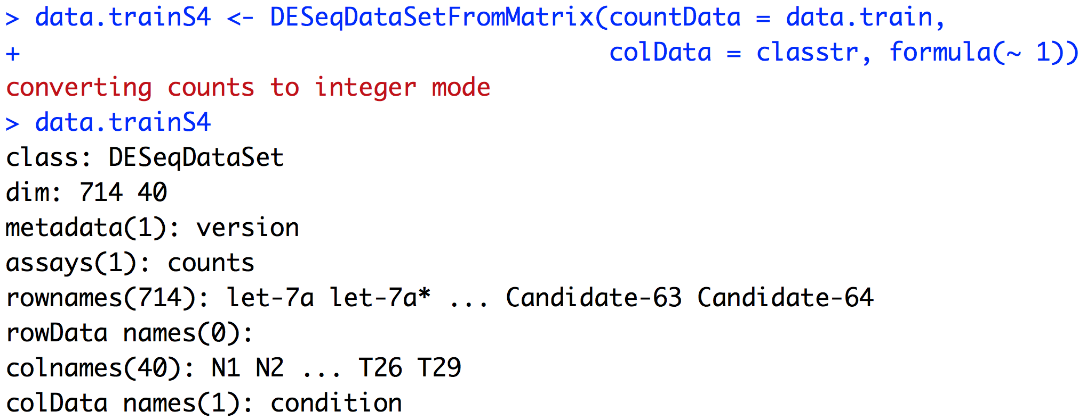
MLSeq 2.0 / DATA INPUT
MLSeq 2.0: MACHINE-LEARNING INTERFACE FOR RNA-SEQUENCING DATA
GÖKMEN ZARARSIZ
RNA-SEQ CLASSIFICATION
PROBLEM
RNA-SEQ CLASSIFICATION
METHODOLOGY
MLSeq 2.0
CONCLUSION
REFERENCES
Notes:
Let’s see how it works.

Slide 24
MLSeq 2.0 / DATA INPUT
MLSeq 2.0: MACHINE-LEARNING INTERFACE FOR RNA-SEQUENCING DATA
GÖKMEN ZARARSIZ
RNA-SEQ CLASSIFICATION
PROBLEM
RNA-SEQ CLASSIFICATION
METHODOLOGY
MLSeq 2.0
CONCLUSION
REFERENCES
pxn dimensional data.frame
nx1 dimensional data.frame
design matrix
An S4 class for data storage
714 features, 40 samples
Raw RNA-Seq counts
feature names
sample names
class labels
Notes:
Input data should be in S4 DESeqDataSet class. How to do it? Simply, we can use the DESeqDataSetFromMatrix function. We put our raw data and class variable inside this function. If we have multiple class variables, we can define a design matrix here. So, this is our data. We have 714 features, which belong to 40 samples.

Slide 25
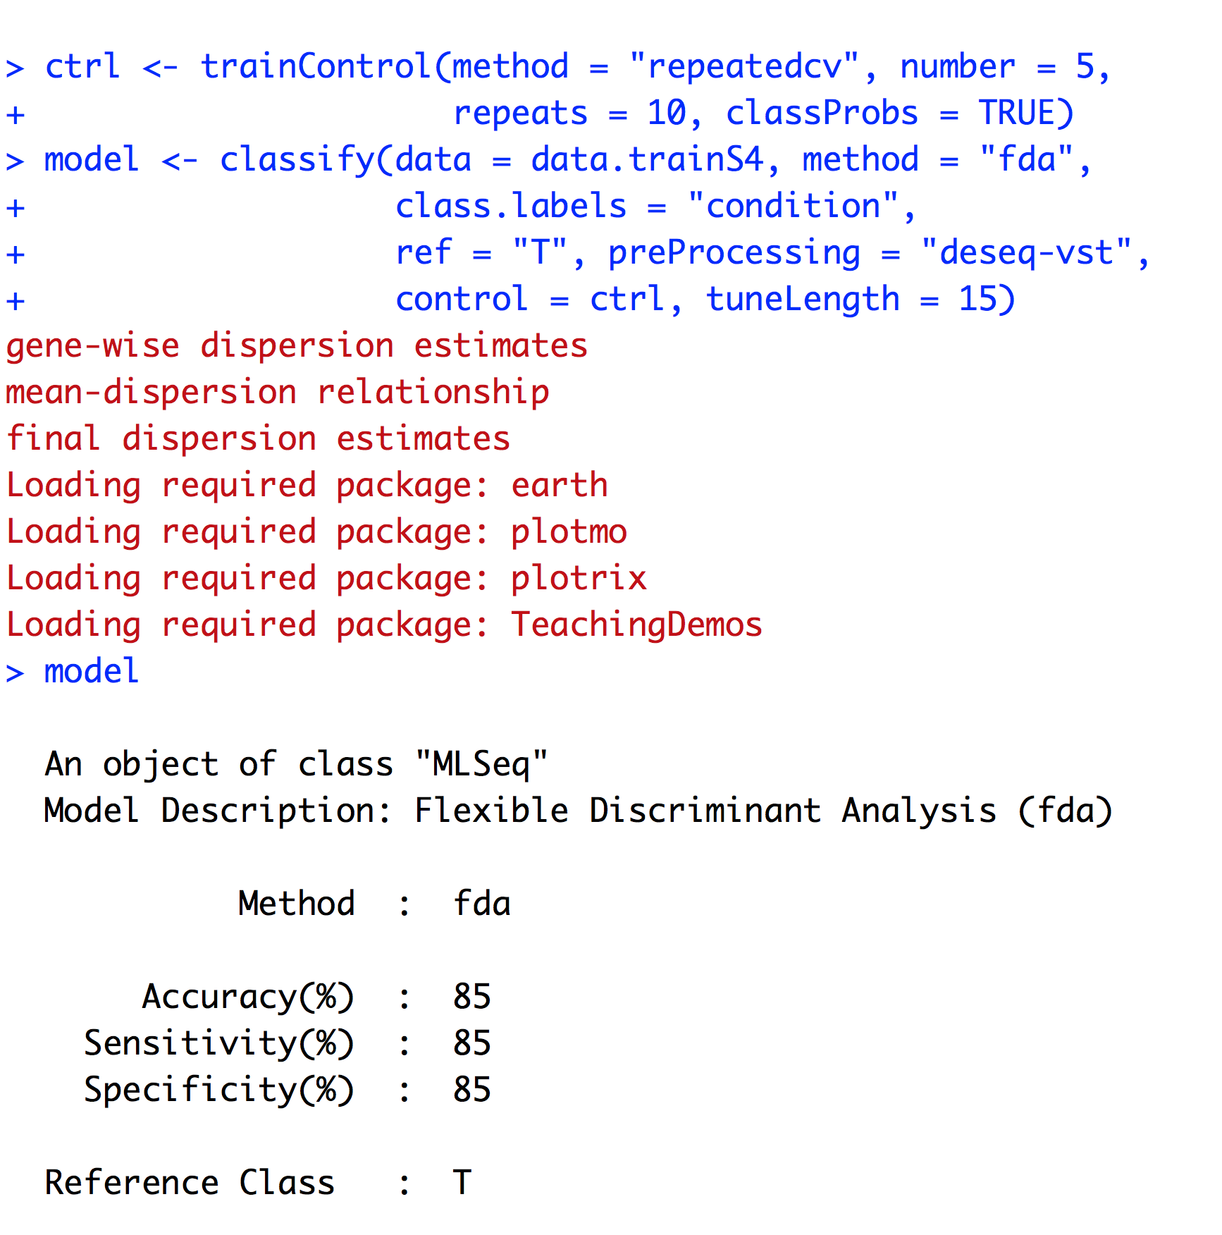
MLSeq 2.0 / CLASSIFY FUNCTION
MLSeq 2.0: MACHINE-LEARNING INTERFACE FOR RNA-SEQUENCING DATA
GÖKMEN ZARARSIZ
RNA-SEQ CLASSIFICATION
PROBLEM
RNA-SEQ CLASSIFICATION
METHODOLOGY
MLSeq 2.0
CONCLUSION
REFERENCES
Notes:
We can simply build models in a single classify(...) function. If we want to apply resampling, we can use trainControl(...) function first.

Slide 26
MLSeq 2.0 / CLASSIFY FUNCTION
MLSeq 2.0: MACHINE-LEARNING INTERFACE FOR RNA-SEQUENCING DATA
GÖKMEN ZARARSIZ
RNA-SEQ CLASSIFICATION
PROBLEM
RNA-SEQ CLASSIFICATION
METHODOLOGY
MLSeq 2.0
CONCLUSION
REFERENCES
control argument for the training process (e.g. resampling)
DESeqDataSet object
ML method for model building
See availableMethods()
class labels
Positive class category important for sens, spec, etc.
Normalization and transformation method
number of values, which will be used in parameter optimization process
train control object
Built model is in MLSeq object. This object stores training parameters
Flexible discriminant analysis built a model with 85% accuracy
Notes:
For example, here I selected repeated cross validation method. I used 5-fold cross-validation and repeated the process for 10 times. In classify(...) function, I define my raw data here, class variable here, and the reference class here. This is required for performance assessment metrics like sensitivity or specificity. Here, I selected flexible discriminant analysis method to fit the model. The entire list of classifiers can be found with the availableMethods(...) function. I normalized my data with deseq, and transfomed my data with variance stabilizing transformation method. After fitting the model, we obtain an object in MLSeq class. This object stores all information need for prediction. Here, flexible discriminant analysis built a model with 85% accuracy.

Slide 27
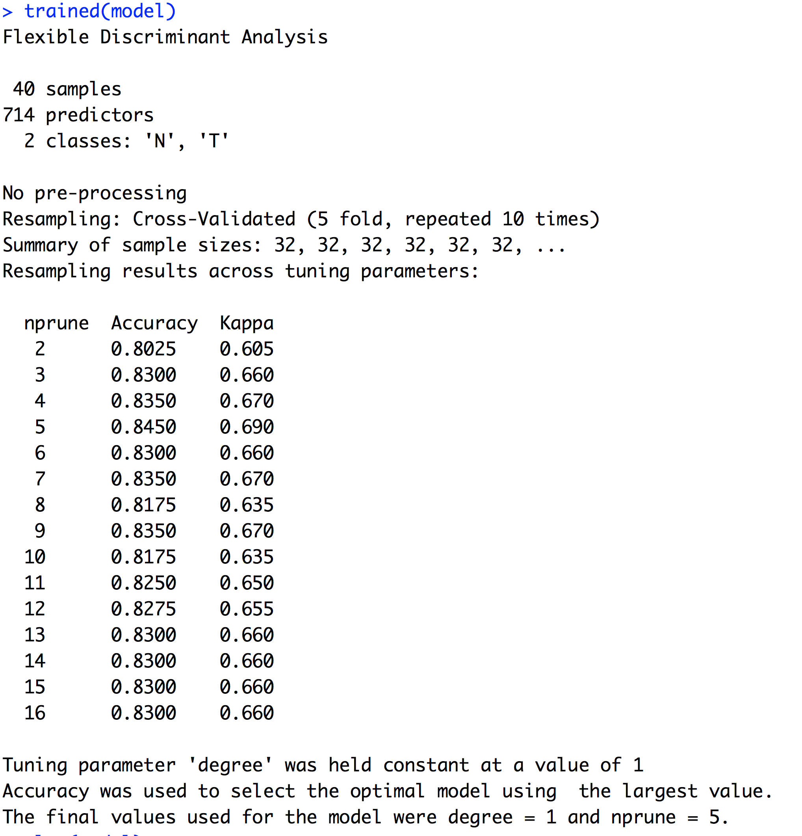
MLSeq 2.0 / PARAMETER TUNING
MLSeq 2.0: MACHINE-LEARNING INTERFACE FOR RNA-SEQUENCING DATA
GÖKMEN ZARARSIZ
RNA-SEQ CLASSIFICATION
PROBLEM
RNA-SEQ CLASSIFICATION
METHODOLOGY
MLSeq 2.0
CONCLUSION
REFERENCES
Optimal parameter
Notes:
We can use trained(...) function

Slide 28
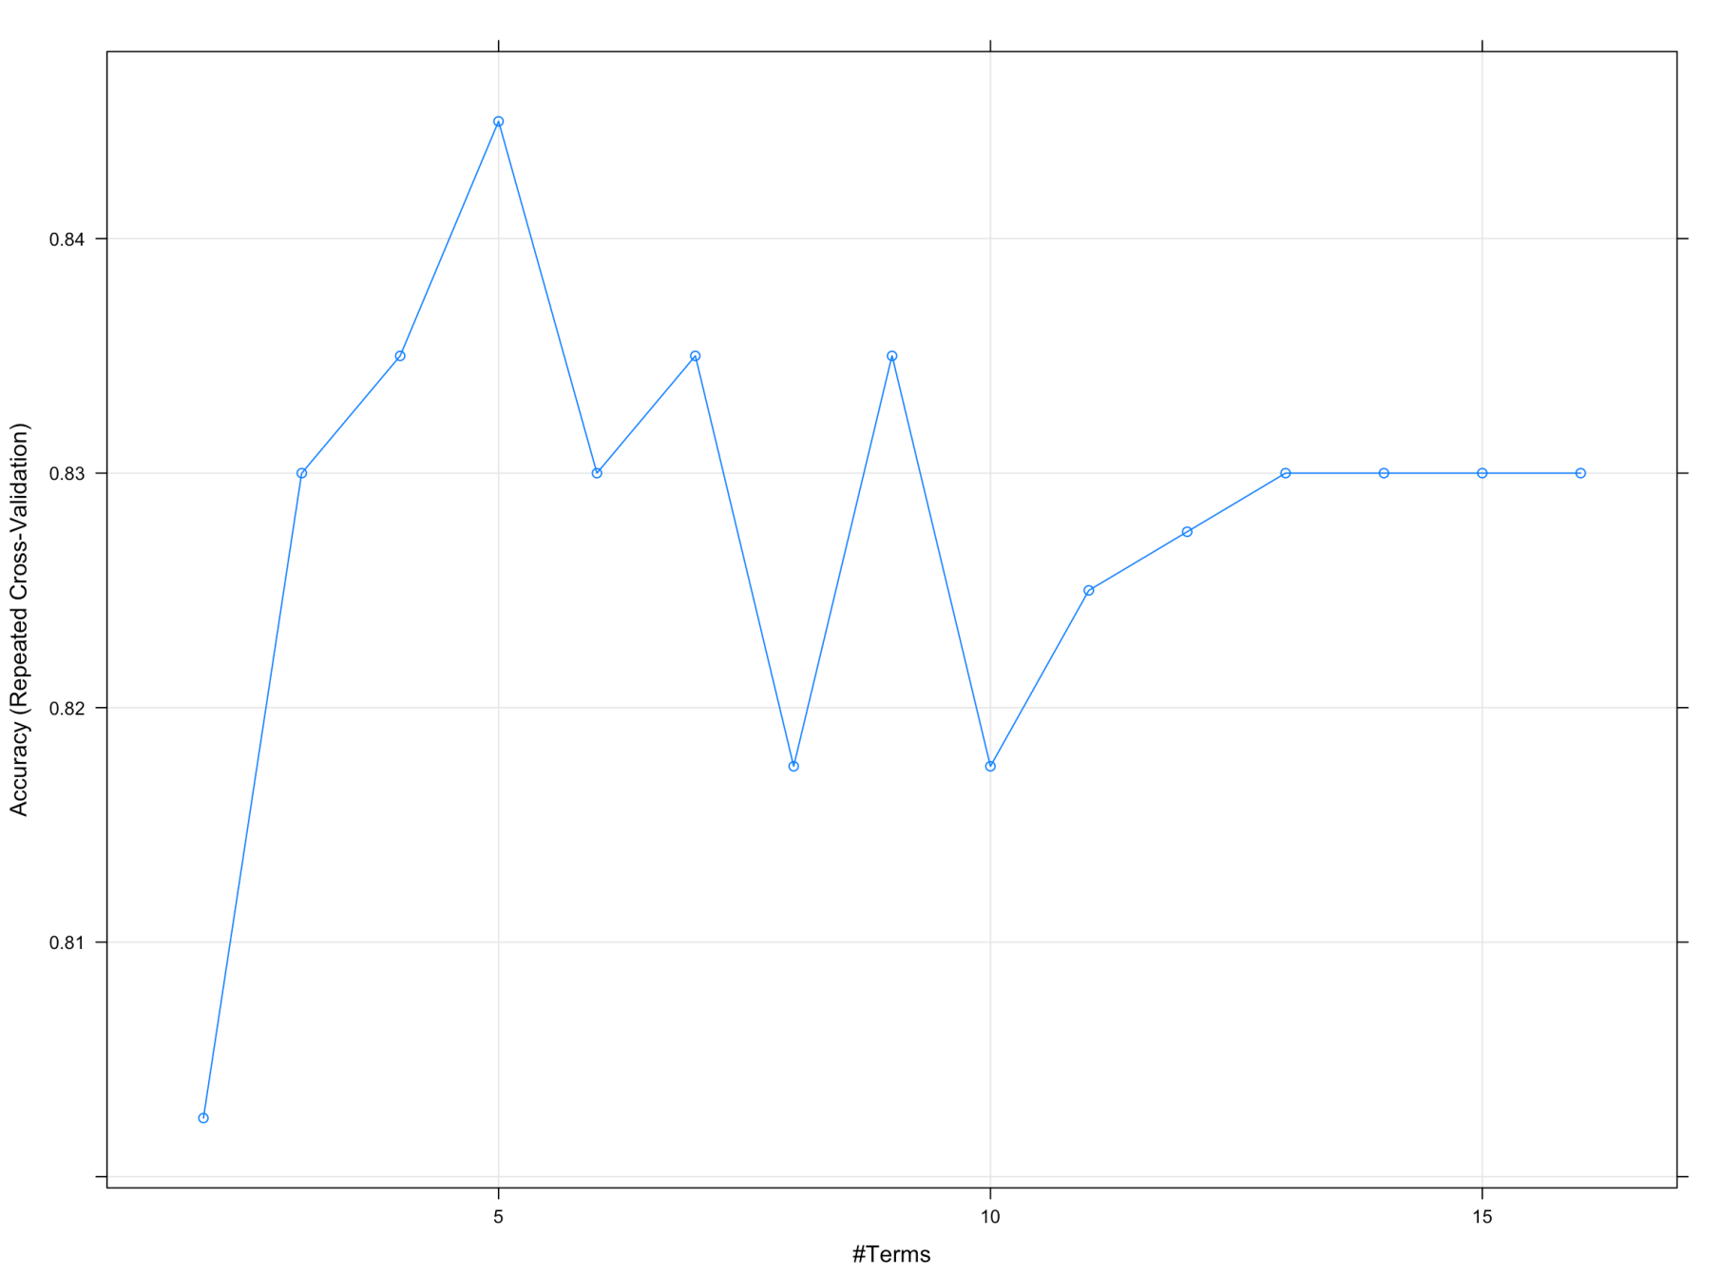
MLSeq 2.0 / PARAMETER TUNING
MLSeq 2.0: MACHINE-LEARNING INTERFACE FOR RNA-SEQUENCING DATA
GÖKMEN ZARARSIZ
RNA-SEQ CLASSIFICATION
PROBLEM
RNA-SEQ CLASSIFICATION
METHODOLOGY
MLSeq 2.0
CONCLUSION
REFERENCES
> plot(model)
Notes:
Or plot(...) function to display the parameter tuning process. For example, this parameter is the best, since it has the highest accuracy.

Slide 29
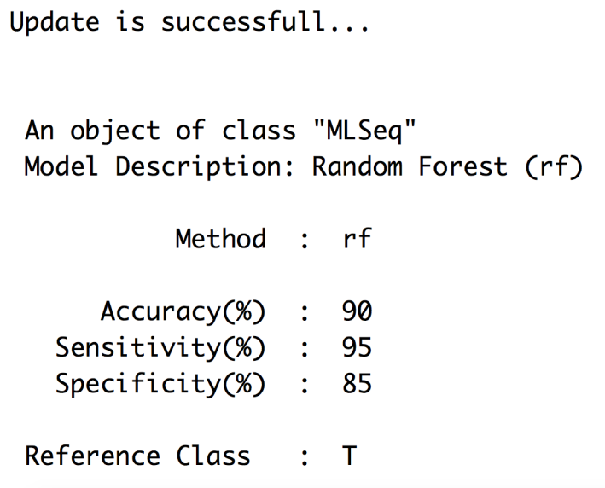
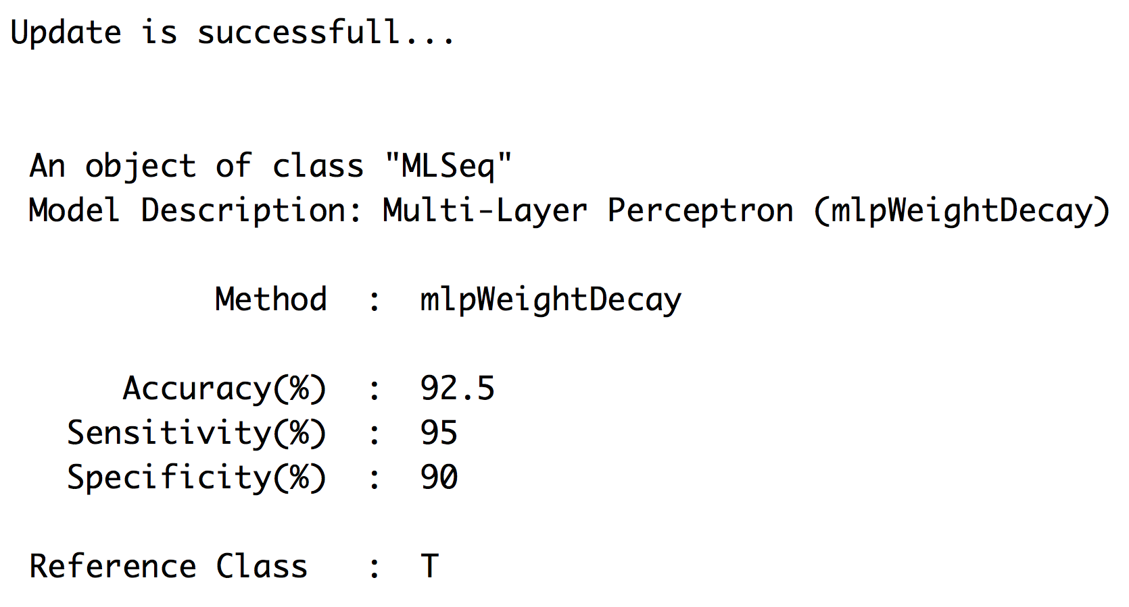
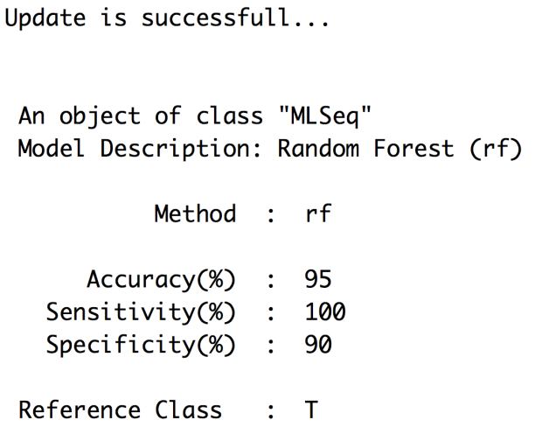
MLSeq 2.0 / UPDATE FUNCTION
MLSeq 2.0: MACHINE-LEARNING INTERFACE FOR RNA-SEQUENCING DATA
GÖKMEN ZARARSIZ
RNA-SEQ CLASSIFICATION
PROBLEM
RNA-SEQ CLASSIFICATION
METHODOLOGY
MLSeq 2.0
CONCLUSION
REFERENCES
> method(model) <- "rf"
> update(model)
> preProcessing(model) <- ”deseq-logcpm"
> update(model)
> method(model) <- ”mlpWeightDecay"
> update(model)
> ctrl <- trainControl(method = ”cv”, 10)
> control(model) <- ctrl
> update(model)
Notes:
And update(...). This is my favourite function. Let’s consider that we are not satisfied with our model, we can practically change the classifier. For example, I changed my model object to random forest classifier and updated. So easy. Or, I prefered using a deep learning model, and updated. We can change our preprocessing method or the resampling method. Lets say, I want to use ten-fold cross-validation method. We can change every arguments of classify(...) function and simply update our model.

Slide 30
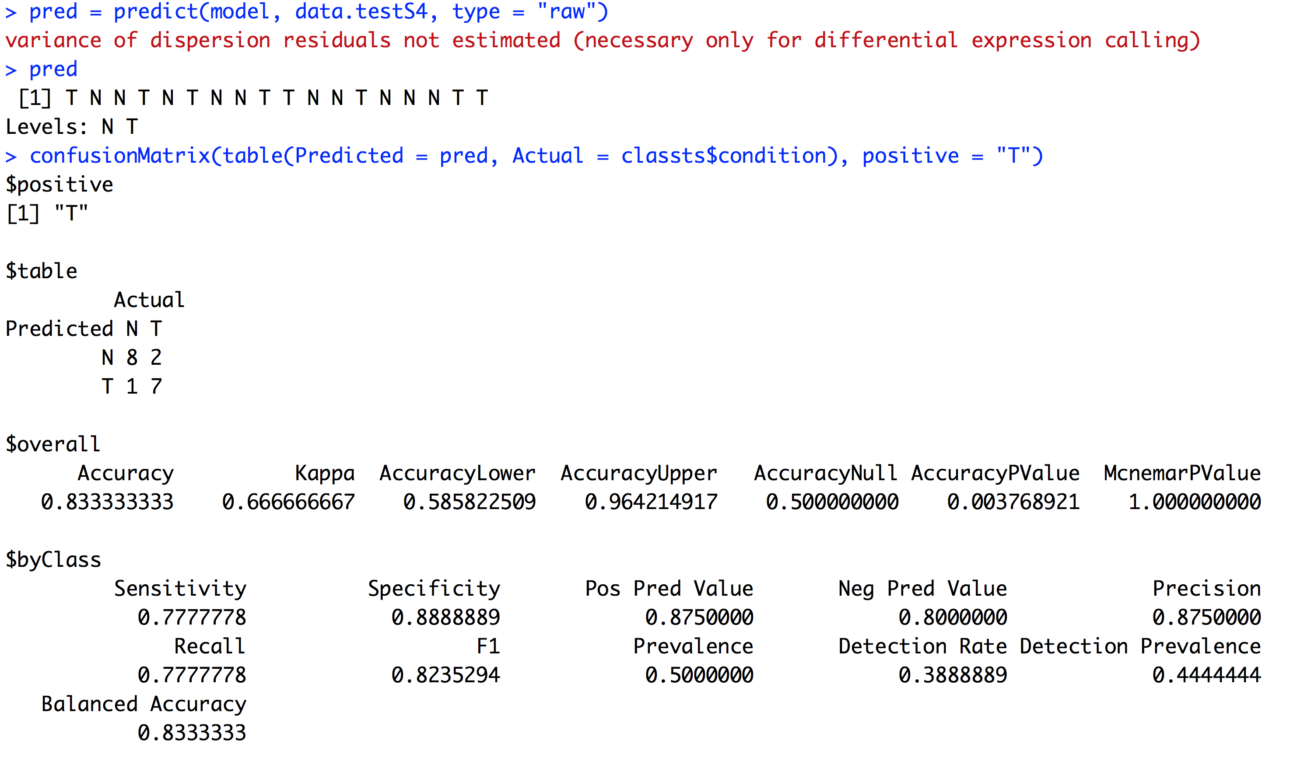
MLSeq 2.0 / PREDICTION & PERFORMANCE ASSESSMENT
MLSeq 2.0: MACHINE-LEARNING INTERFACE FOR RNA-SEQUENCING DATA
GÖKMEN ZARARSIZ
RNA-SEQ CLASSIFICATION
PROBLEM
RNA-SEQ CLASSIFICATION
METHODOLOGY
MLSeq 2.0
CONCLUSION
REFERENCES

Slide 31
MLSeq 2.0 / PREDICTION & PERFORMANCE ASSESSMENT
MLSeq 2.0: MACHINE-LEARNING INTERFACE FOR RNA-SEQUENCING DATA
GÖKMEN ZARARSIZ
RNA-SEQ CLASSIFICATION
PROBLEM
RNA-SEQ CLASSIFICATION
METHODOLOGY
MLSeq 2.0
CONCLUSION
REFERENCES
Test data in DESeqDataSet
S4 class
MLSeq object
“raw” for class predictions, “prob” for class probabilities
Confusion matrix
Statistical measures calculated from the confusion matrix
Notes:
After building the model, we can predict our new data using predict(...) function and assess our model performance with the confusionMatrix(...) function. MLSeq provides a detailed summary of the model performance.

Slide 32
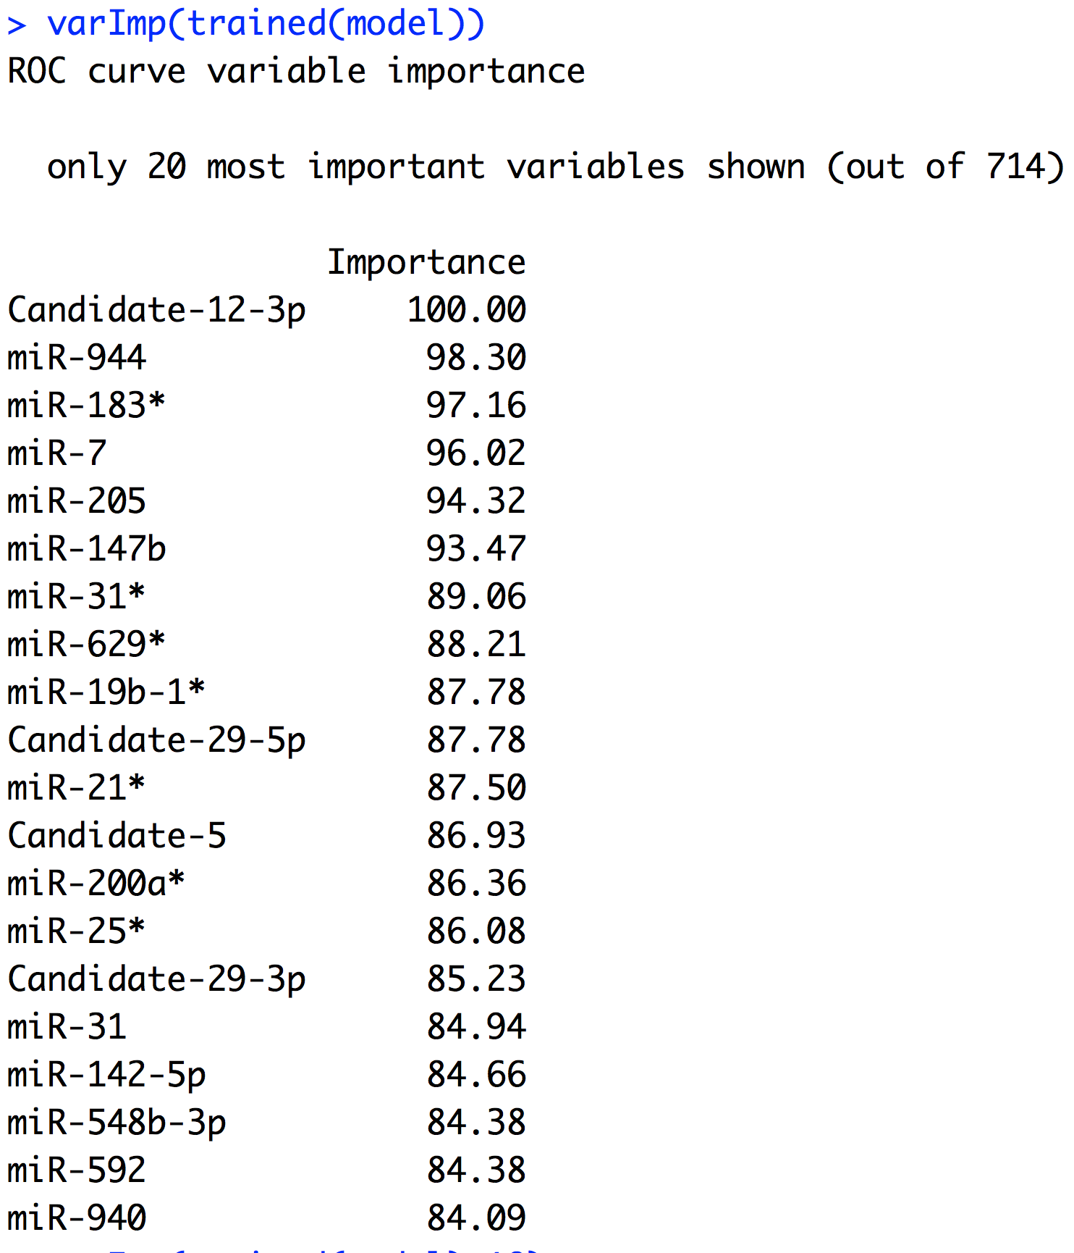
MLSeq 2.0 / VARIABLE IMPORTANCE
MLSeq 2.0: MACHINE-LEARNING INTERFACE FOR RNA-SEQUENCING DATA
GÖKMEN ZARARSIZ
RNA-SEQ CLASSIFICATION
PROBLEM
RNA-SEQ CLASSIFICATION
METHODOLOGY
MLSeq 2.0
CONCLUSION
REFERENCES
Notes:
Also, we can order our features from most important to least important. For example, this feature is detected as the most important feature.

Slide 33
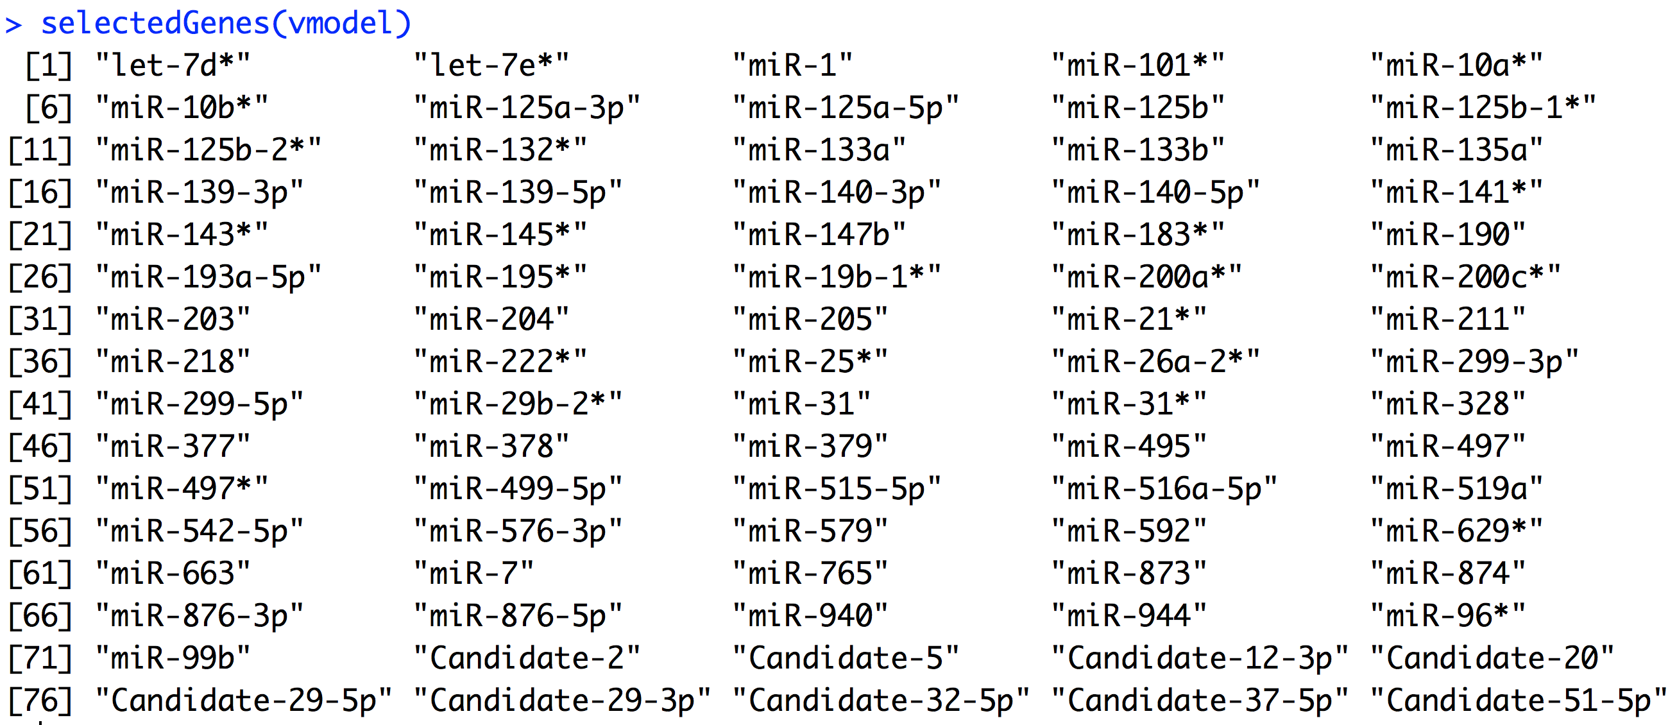
MLSeq 2.0 / DIAGNOSTIC BIOMARKER DISCOVERY
MLSeq 2.0: MACHINE-LEARNING INTERFACE FOR RNA-SEQUENCING DATA
GÖKMEN ZARARSIZ
RNA-SEQ CLASSIFICATION
PROBLEM
RNA-SEQ CLASSIFICATION
METHODOLOGY
MLSeq 2.0
CONCLUSION
REFERENCES
Notes:
And we can use selectedGenes(...) function to display the diagnostic biomarkers for the sparse classifiers.

Slide 34
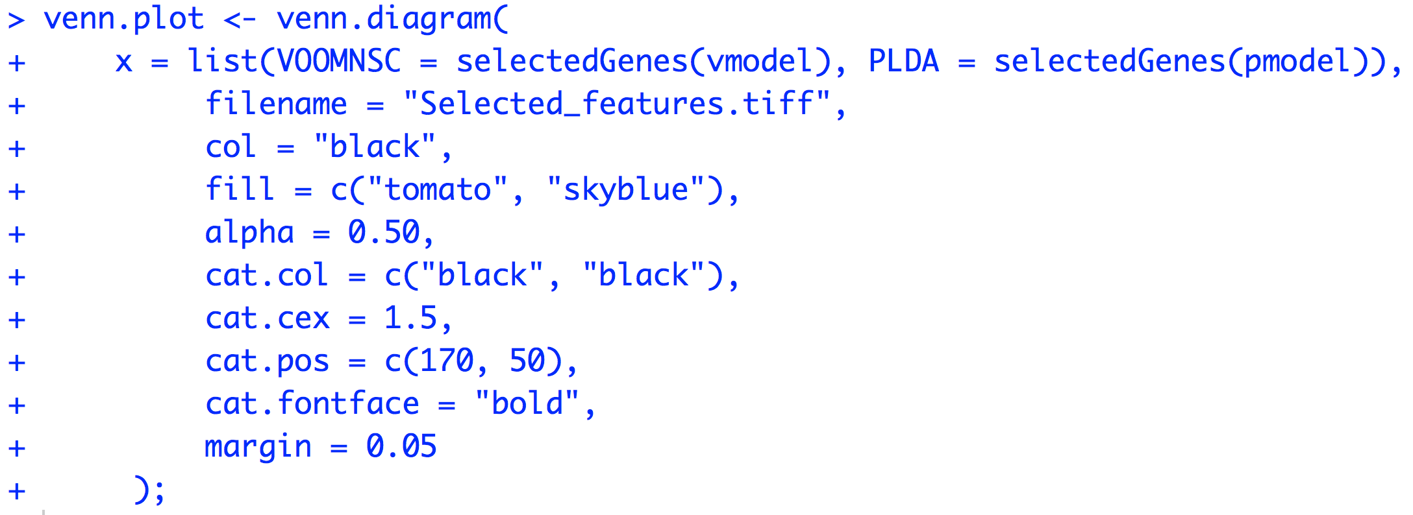
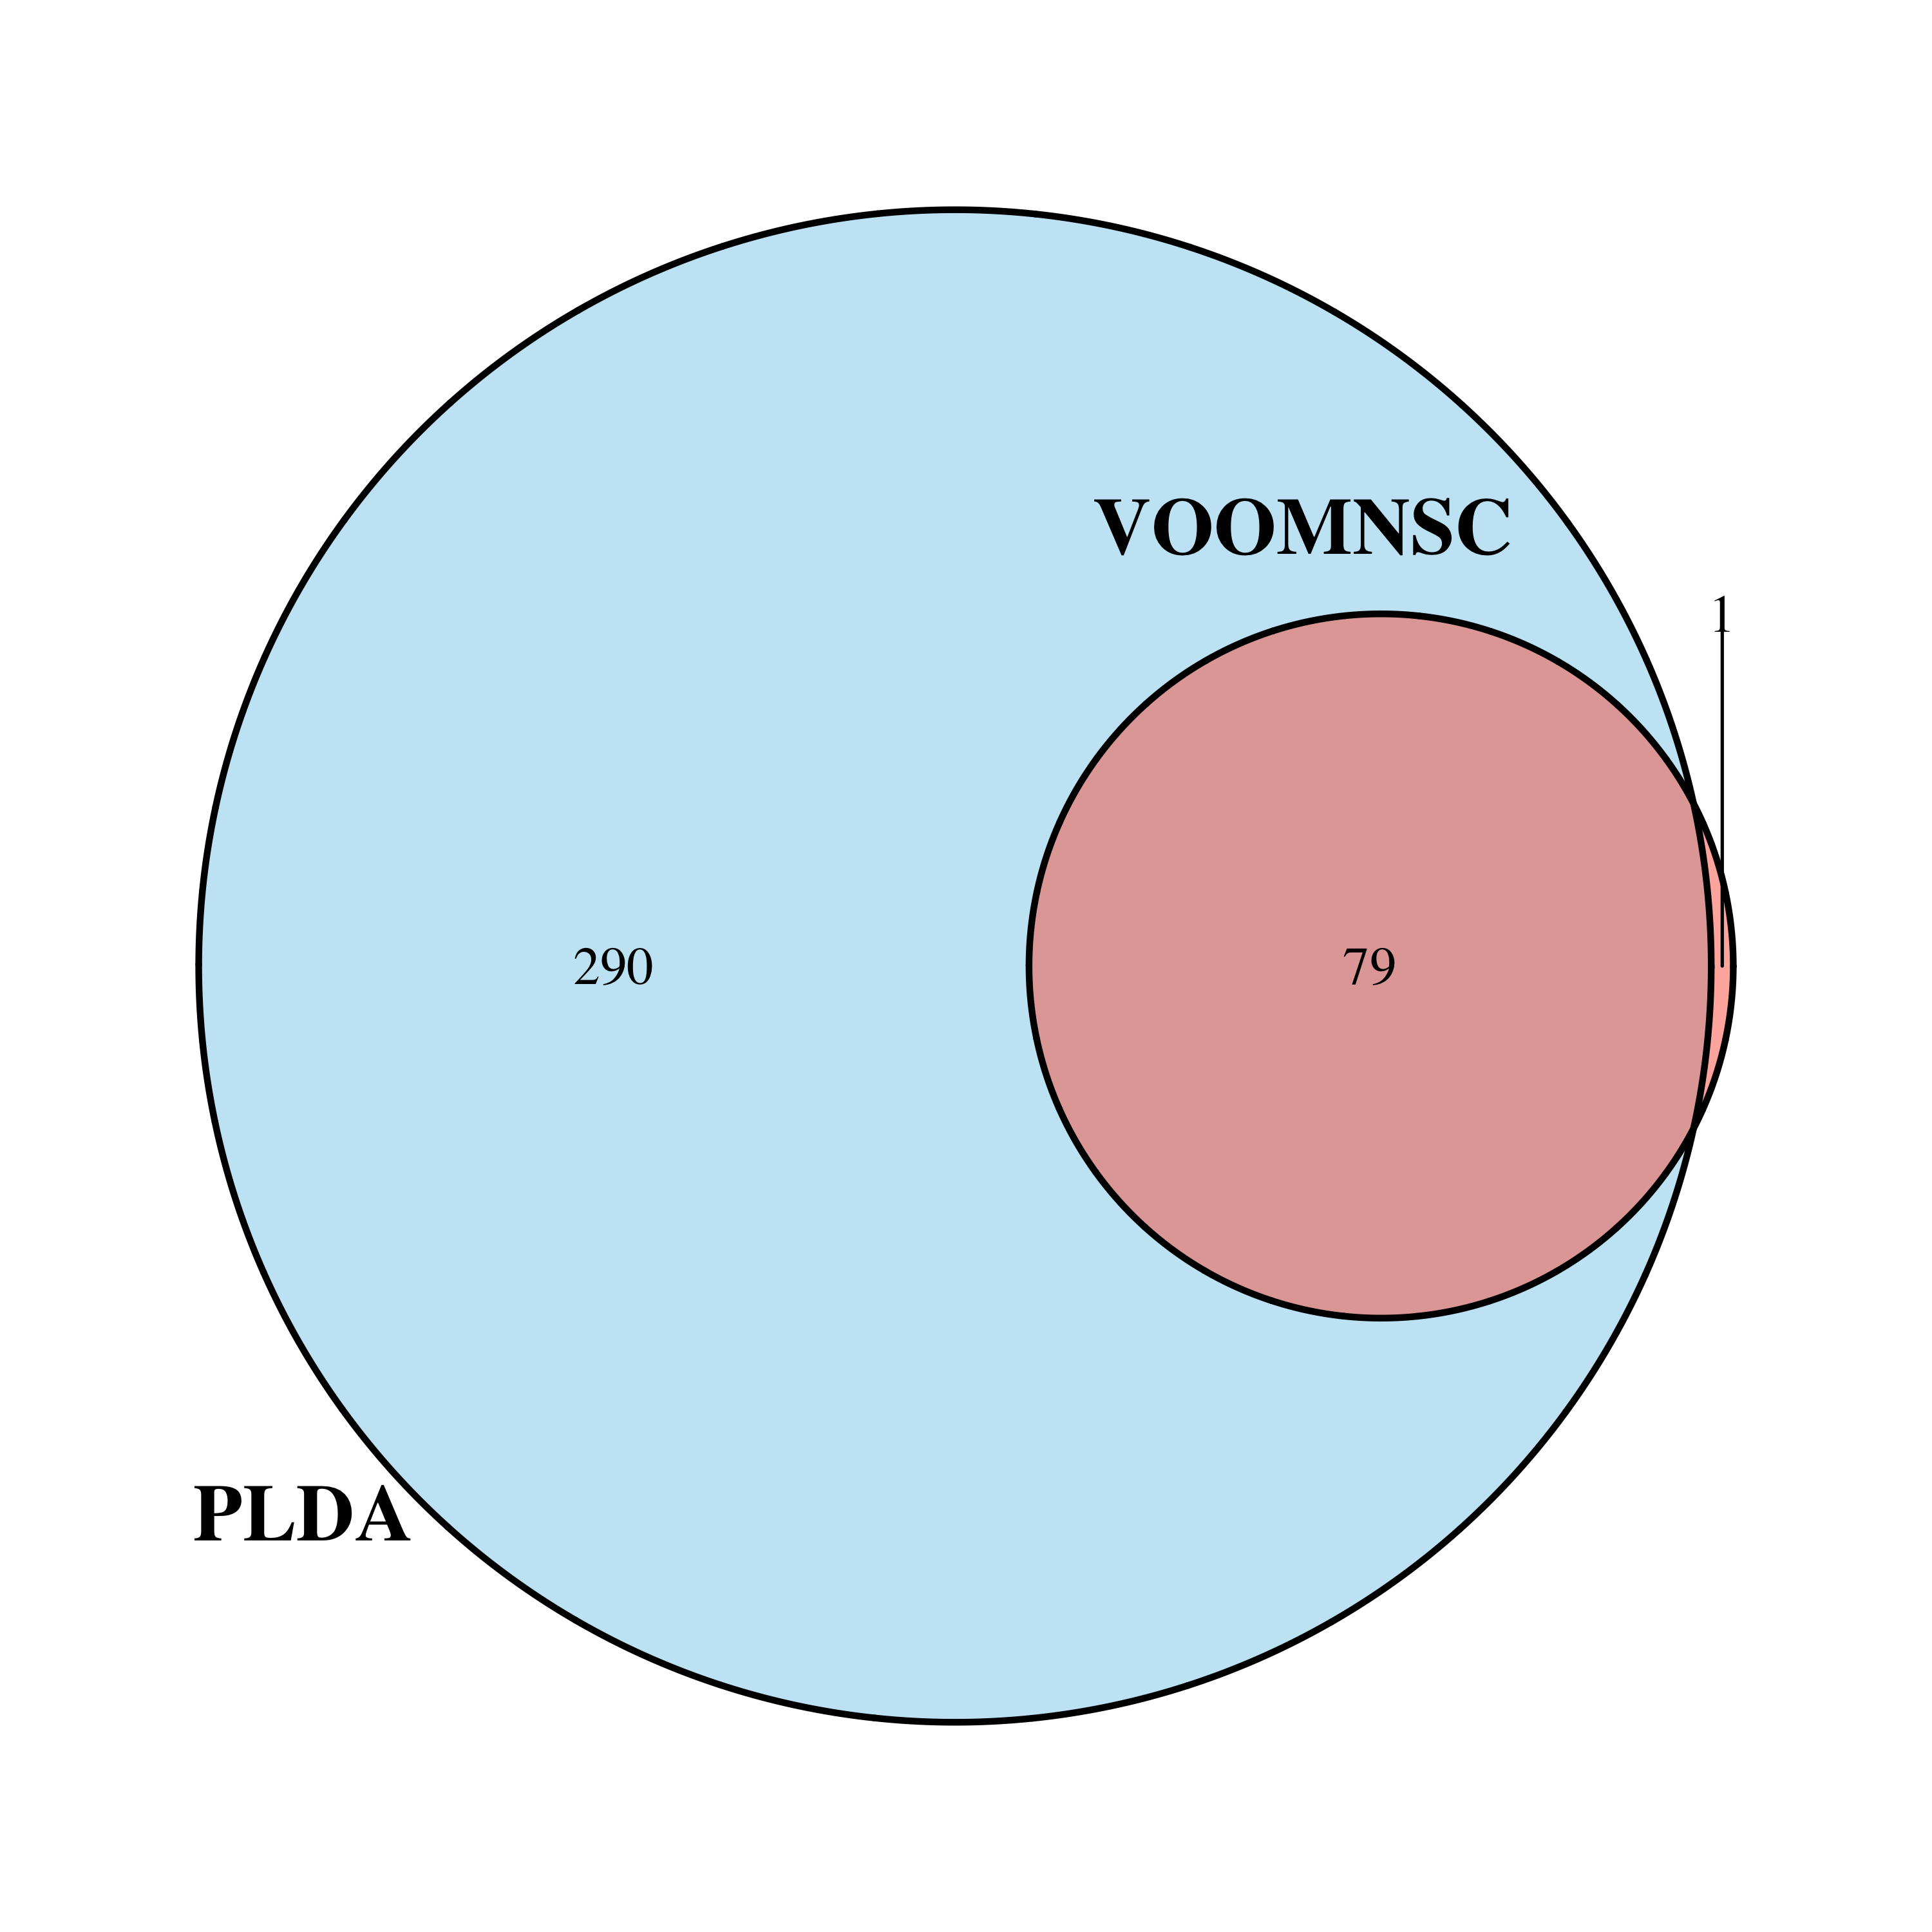
MLSeq 2.0 / DIAGNOSTIC BIOMARKER DISCOVERY
MLSeq 2.0: MACHINE-LEARNING INTERFACE FOR RNA-SEQUENCING DATA
GÖKMEN ZARARSIZ
RNA-SEQ CLASSIFICATION
PROBLEM
RNA-SEQ CLASSIFICATION
METHODOLOGY
MLSeq 2.0
CONCLUSION
REFERENCES
Notes:
And finally, we can draw Venn-diagrams to see how many features are overlapped between sparse classifiers.

Slide 35
REFERENCES
MLSeq 2.0: MACHINE-LEARNING INTERFACE FOR RNA-SEQUENCING DATA
GÖKMEN ZARARSIZ
RNA-SEQ CLASSIFICATION
PROBLEM
RNA-SEQ CLASSIFICATION
METHODOLOGY
MLSeq 2.0
CONCLUSION
REFERENCES
Anders S, et al. (2010) Differential expression analysis for sequence count data. Genome Biology, 11(10):R106.
Dong K, et al. (2016) NBLDA: negative binomial linear discriminant analysis for RNA-Seq data. BMC Bioinformatics. 17(1):369. doi: 10.1186/s12859-016-1208-1.
Kuhn M (2008) Building Predictive Models in R Using the caret Package. Journal of Statistical Software, 28(5).
Law et al. (2014) Voom: precision weights unlock linear model analysis tools for RNA-seq read counts, Genome Biology, 15:R29, doi:10.1186/gb-2014-15-2-r29
Robinson MD et al. (2010) A scaling normalization method for differential expression analysis of RNA-seq data. Genome Biology, 11:R25, doi:10.1186/gb-2010-11-3-r25.
Witten D, et al. (2010) Ultra-high throughput sequencing-based small RNA discovery an discrete statistical biomarker analysis in a collection of cervical tumors and matched controls. BMC Biology, 8(58).
Witten DM (2011). Classification and clustering of sequencing data using a poisson model. The Annals of Applied Statistics, 5(4), 2493–2518.
Zararsiz G, et al. (2014) Classification of RNA-Seq data via bagging support vector machines. bioRxiv, doi: http://dx.doi.org/10.1101/007526
Zararsiz G, et al. (2017) MLSeq: Machine learning interface for RNA-Seq data. R package version 2.0.0.
Zararsiz G, et al. (2017) A comprehensive simulation study on classification of RNA-Seq data. Plos One, https://doi.org/10.1371/journal.pone.0182507
Zararsiz G, et al. (2017) voomDDA: discovery of diagnostic biomarkers and classification of RNA-seq data. PeerJ, 5:e3890 https://doi.org/10.7717/peerj.3890
Notes:
These are some of the references. Thank you for listening.

